Slide 1
IPL DATA ANALYSIS 2008- 2017
Shankar GS

Slide 2
IPL Dataset
This dataset consist of an IPL Data which was held between 2008 -2017
We will analyze the performance of each team with respect to each category available in the dataset.
Finally, we can conclude the team performance analysis that combines both qualitative and quantitative metrics.

Slide 3
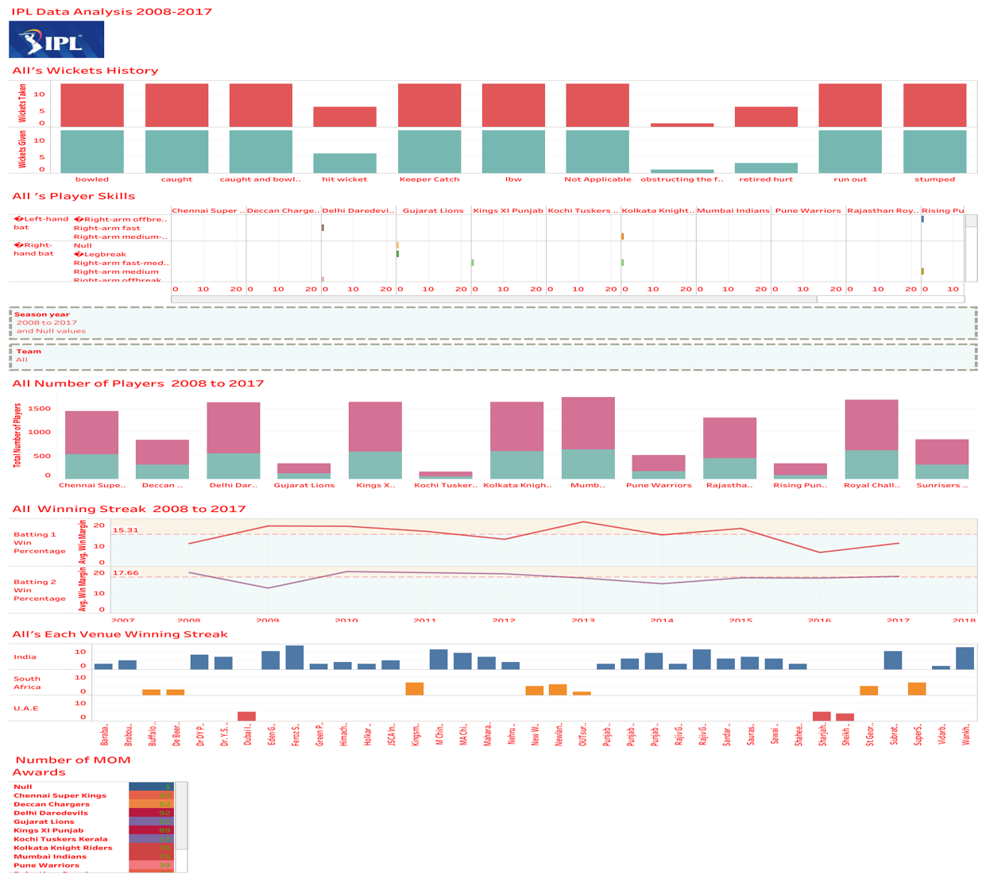
DASHBOARD
Dashboard mainly talks about the below major points.
No. of Players in each team
Player’s Skills in each team
Winning Percentage of each team after winning toss(bat/field)
Venue wise No.of wins for each team
No.of wickets taken vs wicket given for each team
No. of MOM received by each team.

Slide 4
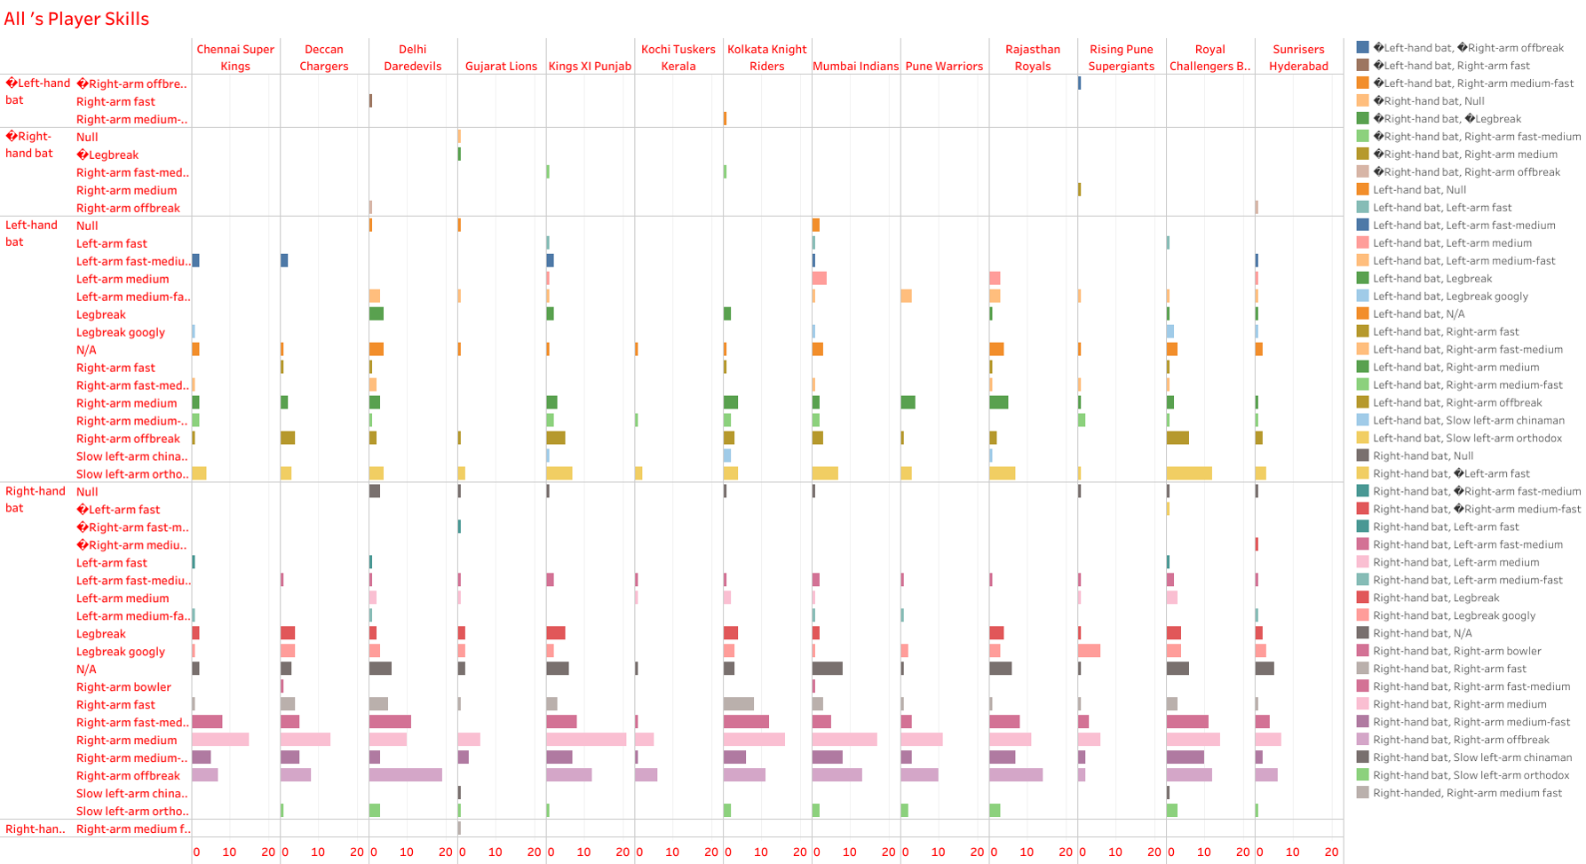
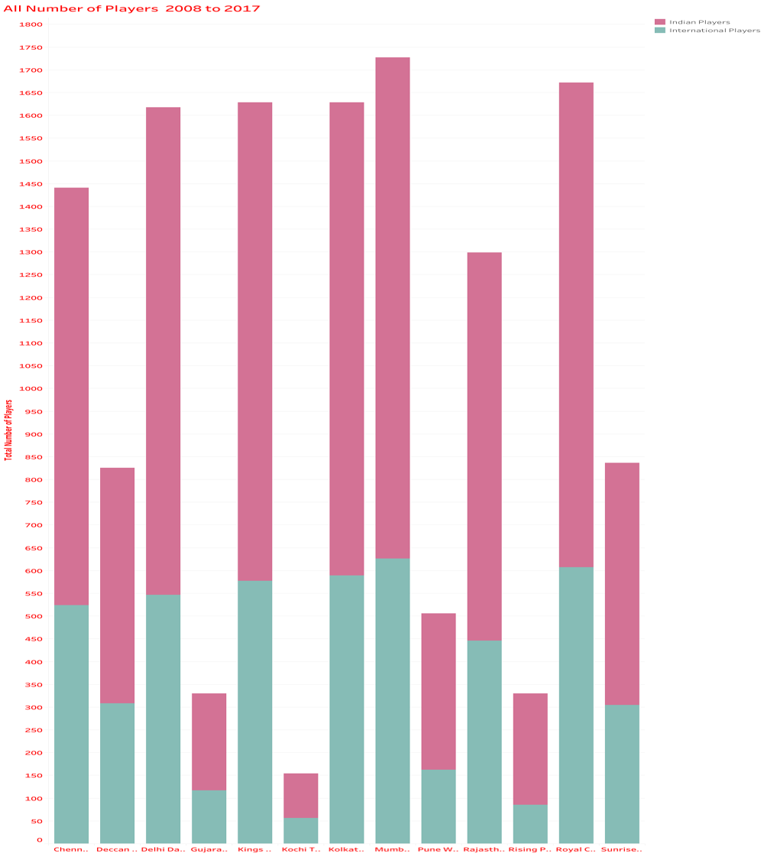
CHARTS
No.of players with their skills
No.of Players in each team(Indian/International)

Slide 5
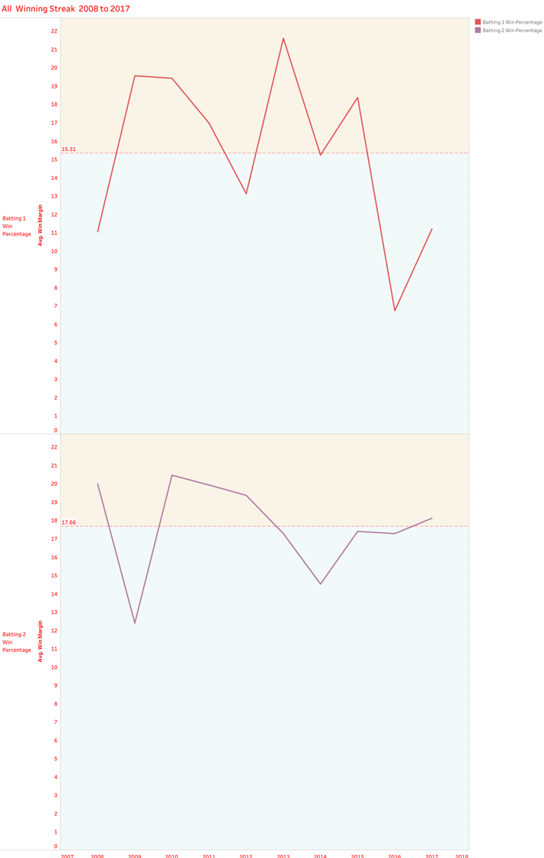
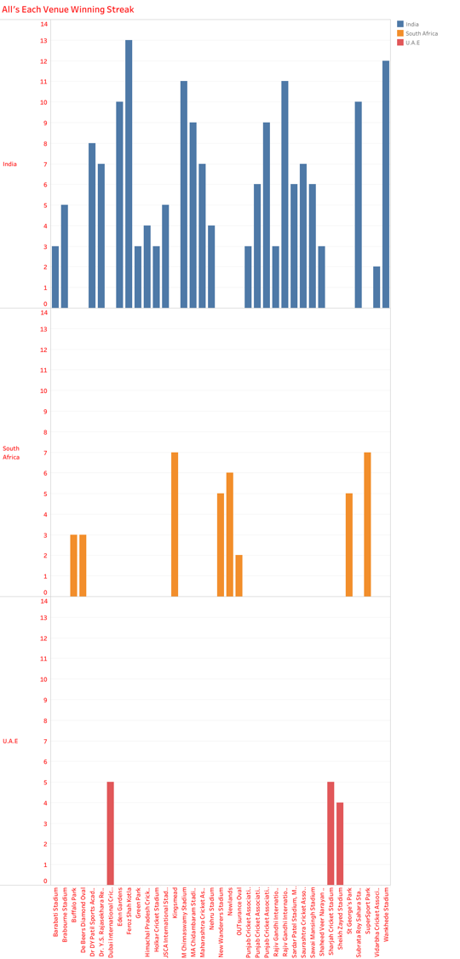
CONTD..
Below Chart shows the Venue wise win counts of each team
Below Chart shows win percentage(Bat 1 vs Bat 2 after winning toss)

Slide 6
INSIGHTS of Analysis
Conclusion
CSK is consistently performing good since 2008.
Players Age between 26-30 years performance is Excellent
Players performance is commendably good whose skills are very good in both bat & ball(all-rounder)
Kochi Tuskers performance is not so good when compared to other team performance.

Slide 7


